Slide 1
Calendario
Sanfrancisquito 2010

Slide 2
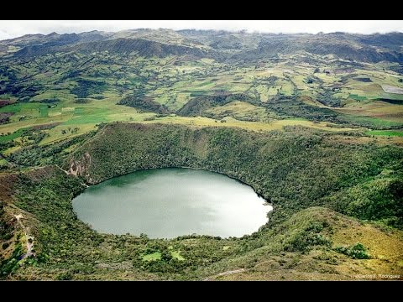
JANUARY 2019
SUNDAY | MONDAY | TUESDAY | ENDNESDAY | THUSDAY | FRIDAY | SATURDAY
 |  |  |  |  | 1 one | 2 two
3 three | 4 four | Five en sanfrancisquito hay una laguna donde hay diversidad de peces y podemos pescar In San Francisco, there is a lagoon where there is a variety of fish and weeds to fish | 6 six | 7 seven | 8 eight | 9 nine
10 ten | 11 once | 12 twelve | 13 thirteen | 14 fourteen | 15 fifteen | 16 eleventh
17 seventeen | 18 eighteen | 19 nineteen | 20 twenty | 21 twenty one | 22 twenty two | 23 twenty three
24 twenty four | 25 twenty fi9ve | 26 twenty six | 27 twenty seven | 28 twenty eight

Slide 3


August 2019
SUNDAY | MONDAY | ENDNESDAY | THUSDAY | FRIDAY | SATURDAY
las características del pato lo definen como un ave acuática de cuello corto pico aplanado y ancho alas de escasa longitud que le permite vuelos cortos así como un cuerpo redondeado cubierto de plumas de diferentes tonalidades se trata de una especie palmípeda ( patas palmeadas) y con las patas muy atrasadas con relación al cuerpo estas características hacen que se desplace de forma elegante. the characteristics of the duck are defined as a short-winged, narrow-winged aqueous wing and wide-width broad wings that allow short flights as well as a rounded body covered with feathers of different shades is a kind palmipeda (pale legs) and with Very late legs related to the body these characteristics make it move elegantly. | en sanfrancisquito encontramos la catedral mas grande del mundo hay muchos santos y la gente viene a pedir milagros a la virgen In San Francisco, we find the largest cathedral in the world, there are many saints and people have to ask miracles to the virgin |  | 1 one | 2 two | 3 three
4 four | 5 five | 7 seven | 8 eight | 9 nine | 10 ten
11 once | 12 twelve | 14 fourteen | 15 fifteen | 16 eleventh | 17 seventeen
18 eighteen | 19 nineteen | 21 twenty one | 22 twenty two | 23 twenty three | 24 twenty four
25 twenty fi9ve | 26 twenty six | 28 twenty eight | 29 twenty nine | 30 thirty | 31 thirty one

